Slide 1

Wholesaler Cashier APP on C++
Group 1
David Julian Ernestine
Muhammad Rafi Aulia
Isaac Gideon Simamora

Slide 2
SYSTEM ANALYSIS
In this project we make wholesaler cashier menu with C++. In this application, we can see the wholesaler menu, prices, total ordered price and the changes.

Slide 3
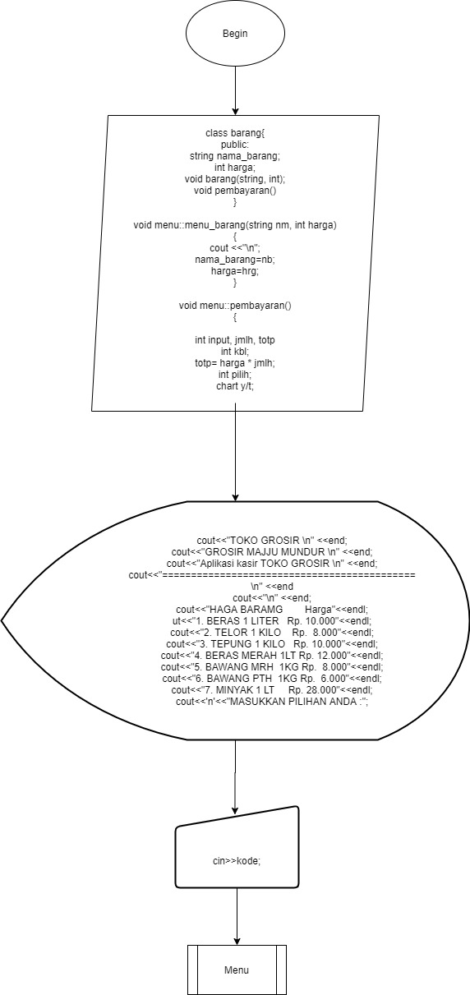
FLOWCHART

Slide 4
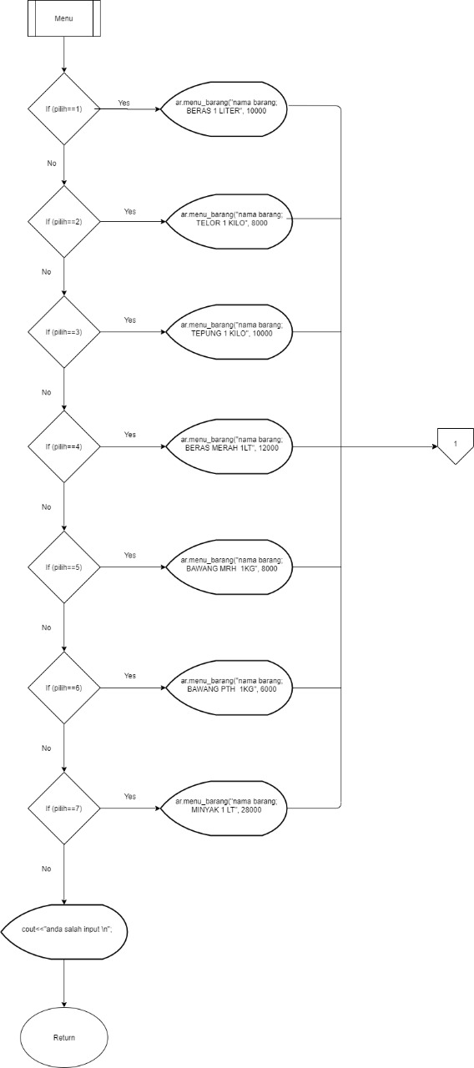
FLOWCHART

Slide 5
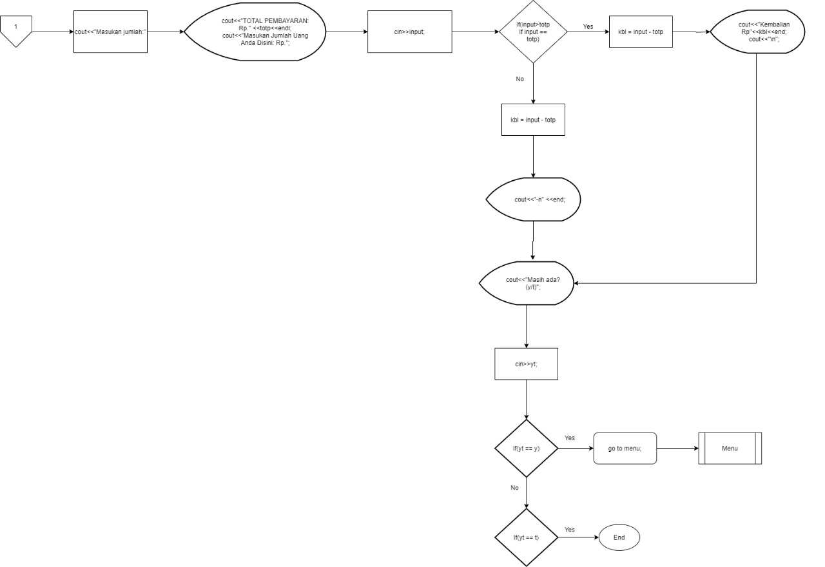
FLOWCHART

Slide 6
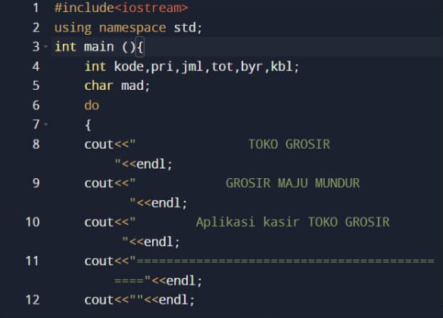
C++ CODE INPUT

Slide 7
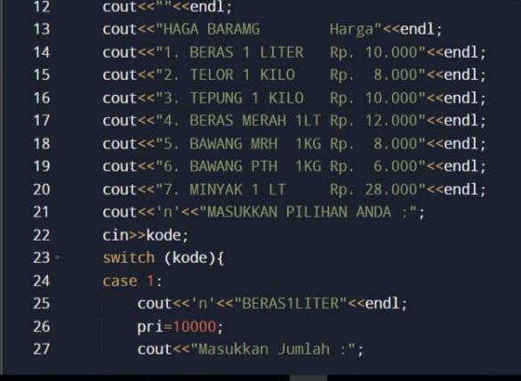
C++ CODE INPUT

Slide 8
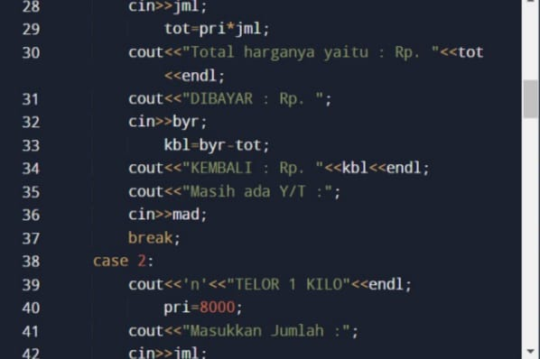
C++ CODE INPUT

Slide 9
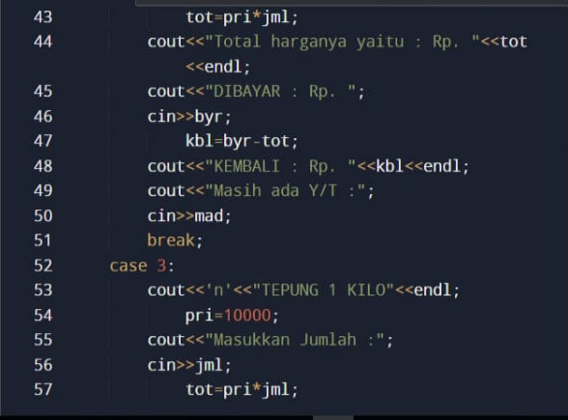
C++ CODE INPUT

Slide 10
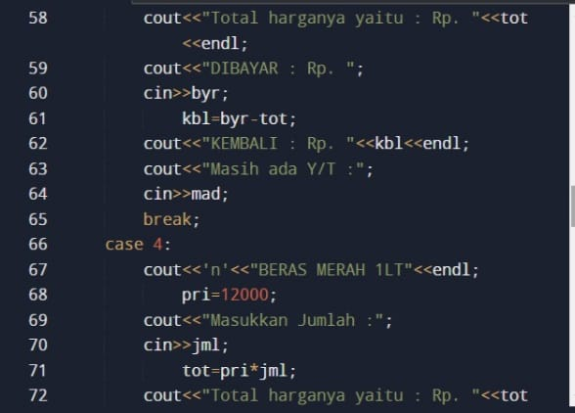
C++ CODE INPUT

Slide 11
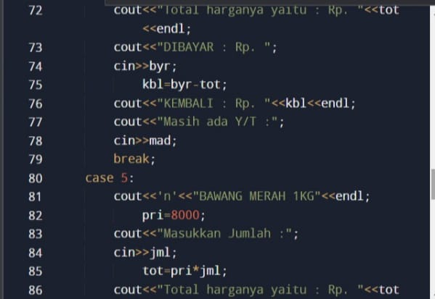
C++ CODE INPUT

Slide 12
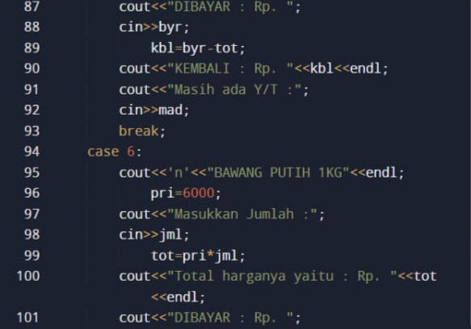
C++ CODE INPUT

Slide 13
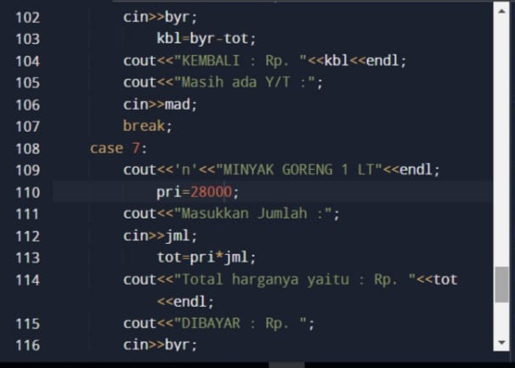
C++ CODE INPUT

Slide 14
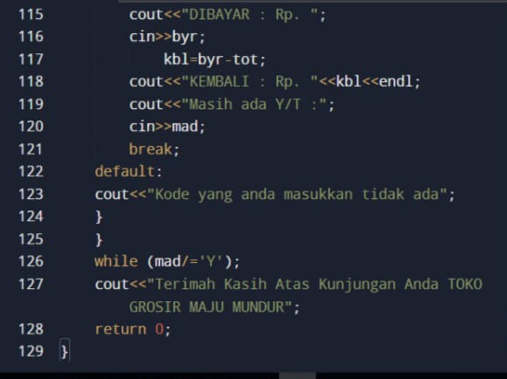
C++ CODE INPUT

Slide 15
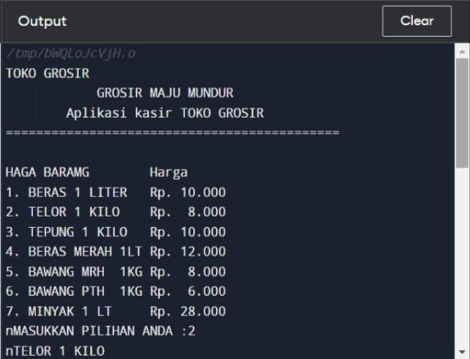
C++ CODE OUTPUT

Slide 16
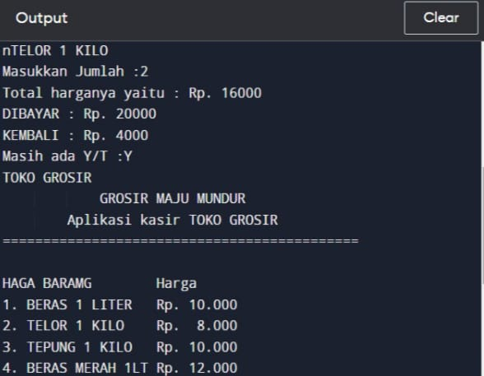
C++ CODE OUTPUT

Slide 17
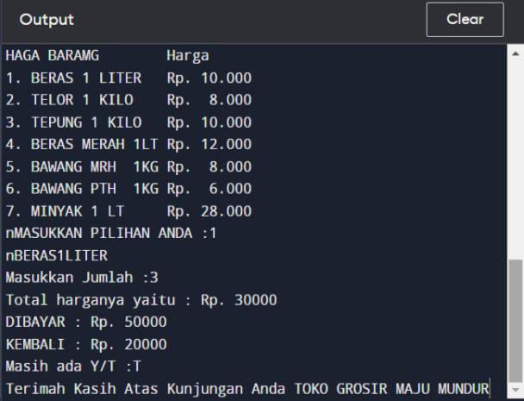
C++ CODE OUTPUT

Slide 18
Thank You
Power point by:
David Julian Ernestine
Muhammad Rafi Aulia
Isaac Gideon Simamora

